Slide 1


Introduction to Classification
Notes:
Classification is the process of predicting the class of given data points. Classes are sometimes called as targets/ labels or categories. There are many applications for classification in many domains such as in credit approval, medical diagnosis, target marketing etc. In this module, we cover the fundamental concepts related to classification. More specifically, we explain the differences between classification and regression and then review the concepts of probability and odds. The maximum likelihood estimation method is the discussed which is the basis of logistic regression classification model that is subsequently introduced. Finally, different classification error types are examined and various performance metrics are introduced and discussed.

Slide 2
Classification: Formal Definition
Classification is the problem of identifying to which of a set of categories a new observation belongs, on the basis of a training set of data containing observations whose category membership is known.
Classification is the process of predicting the class of given data points. Classes are sometimes called as targets/ labels or categories. Classification predictive modeling is the task of approximating a mapping function (f) from input variables (X) to discrete output variables (y).
Notes:
Let’s start by defining the classification. Two different definitions are given in here. According to the first definition, classification is the problem of identifying to which of a set of categories a new observation belongs. This is done on a basis of a training set of data that contains observations whose category membership is already known. According to the second definition, classification is the process of predicting the class of a given data point. In this case, classes are sometimes called a target or label categories. Classification predictive modeling is a task of approximating a mapping function (f) that can map the input variables (x) to the output variable (y).

Slide 3
Classification: Formal Definition
Qualitative variables take values in an unordered set C, such as:
eye color ∈ {brown, blue, green}
Given a feature vector X and a qualitative response Y taking values in the set C, the classification task is to build a function C(X) that takes as input the feature vector X and predicts its value for Y ; i.e. C(X) ∈ C.
Often we are more interested in estimating the probabilities that X belongs to each category in C.
Notes:
As you might have noticed, there are significant similarities between classification and regression. In both cases we are looking for mapping function (f) that can take a given vector of features (x) and predict a response variable (y). if the response variable y is a continuous variable, we refer to the task as a regression. On the other hand, if (y) is a categorical variable, or a qualitative variable, the task is called classification. We are often more interested in estimating the probability that x belongs to each of the categories of the target variable.

Slide 4
Classification: Examples
Followings are few examples of cases where data analysis task involves classification:
A bank loan officer wants to analyze the data in order to know which customer (loan applicant) are risky or which are safe.
A marketing manager at a company needs to analyze a customer with a given profile, who will buy a new computer.
An algorithm that decides whether an incoming email is a ‘Spam’ or not.
Notes:
Let’s consider a few examples of classification here. The first example is a bank loan officer who needs to analyze data in order to decide which of the customers or loan applicants are risky and which ones are not. So, as you can see in this case, the target variable has two levels, risky and not risky. Another example is a marketing manager at a company who needs to analyze the customer profile and decide who will buy a new computer. Again, the target in this example is a binary class, buying a computer or not buying a computer. The last example is an algorithm that can decide whether an incoming email is spam or not spam. So again, two categories of spam and not spam are associated with the target variable in here.

Slide 5
Example: Credit Card Defaults
library(ISLR)
library(dplyr)
summary(Default)
## default student balance income ## No :9667 No :7056 Min. : 0.0 Min. : 772 ## Yes: 333 Yes:2944 1st Qu.: 481.7 1st Qu.:21340 ## Median : 823.6 Median :34553 ## Mean : 835.4 Mean :33517 ## 3rd Qu.:1166.3 3rd Qu.:43808 ## Max. :2654.3 Max. :73554
Default %>% group_by(default) %>% summarise(Balanace_Mean=mean(balance),Income_Mean=mean(income))
## # A tibble: 2 x 3 ## default Balanace_Mean Income_Mean ## <fct> <dbl> <dbl> ## 1 No 804 33566 ## 2 Yes 1748 32089
Notes:
Let us consider a numerical example in here, for this example we will be using the default data set which is part of the ISLR library. We will also use the dplyr library for “group by” and “summarize” functions. The first thing is to load the library. So, we have library ISLR and library dplyr. We can also have a quick look at the summary of the variables and the default data set. We can see that the first variable is default which has two levels, no and yes. So, we can see out of the 10,000 applicants, 9,667 applicants have not been defaulted and 333 applicants have been defaulted. The second variable is student which takes two levels, no and yes. So, we can see that we have 2,944 students, and the rest of the population are non-students. The third variable is the balance on the credit card, which we can see is a numerical value where the minimum balance is zero and the maximum is 2,654.3 dollars. Income is the last variable which as we can see is the numerical variable when the minimum and maximum and the quartile variables are shown. An effective way to look at the classification methods is to see the distribution of each of the variables along with values of the target variable. For that we will use the “group by” function and we pass the default data set to the group by function. We will then “group by” all the elements by the default values. Then we summarize the data set and calculate the mean of the balance and the mean of income for each level of the default. The results are shown in here, as we can see we have two default values. No and yes and the mean balance and the mean income is shown for each of them. As we can see, the mean balance for the default applicant is significantly higher than the non-default applicant. More specifically, the average balance for defaulted applicants is 1748 dollars, whereas the mean balance for non-default applicants is 804 dollars.

Slide 6
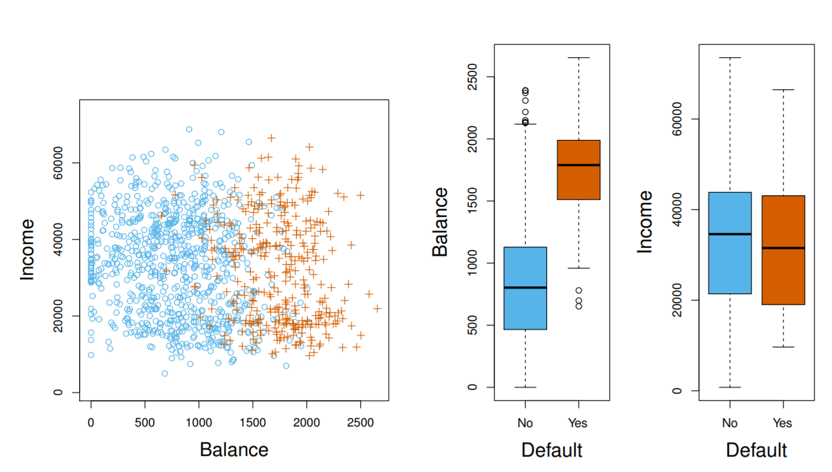
Example: Credit Card Defaults
Notes:
In here we can see the visualization of the results shown on the previous slide. On the left hand-side we can see balance and income as two variables. The non-default applicants in this case are shown with blue circles, and the defaulted applicants are show with the brown plus signs. Similarly, we can see the distribution of balance and income across two levels of the default. For the balance, we can see that the balance value is significantly lower for those applicants ready to default set to no compared to those where the default is set to yes. Here we can say that the variable balance has a strong predictive power because it can separate the two levels of the default. The scenario for income is slightly different as we can see there is significant overlap and the values of income for defaulted and non-defaulted applicants.

Slide 7
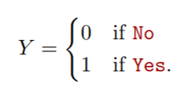
Can we use Linear Regression?
Suppose for the Default classification task that we code
Can we simply perform a linear regression of Y on X and classify as Yes if Y >ˆ 0.5?
In this case of a binary outcome, linear regression can be used as a classifier, but regression might produce probabilities less than zero or bigger than one later.
Notes:
Suppose for the default classification task, we code the dependent variable Y as zero if the default value is no and one if the default value is yes. With this type of encoding you might ask yourself whether we can use linear regression of Y and X to classify which of the applicants would be defaulted. In that case, if Y is greater than 0.5, we can consider the applicant as being defaulted, and if the value of Y is less than 0.5 we can consider the applicant as non-default. Obviously in the case of binary classification, we can use such linear regression models, however this model will not be optimal because the prediction can result in values less than zero or bigger than one, as we can see later on.

Slide 8
Example
Default$default_num=as.numeric(Default$default) model=lm(default_num~balance+income, data=Default) anova(model)
## Analysis of Variance Table ## ## Response: default_num ## Df Sum Sq Mean Sq F value Pr(>F) ## balance 1 39.461 39.461 1398.500 < 2.2e-16 *** ## income 1 0.368 0.368 13.054 0.0003042 *** ## Residuals 9997 282.082 0.028 ## --- ## Signif. codes: 0 '***' 0.001 '**' 0.01 '*' 0.05 '.' 0.1 ' ' 1
Notes:
Here is the implementation of the idea of using linear regression instead of classification. As you can see, we have first converted the default value into numeric, then we used the as dot numeric function to convert the categorical variable default to a numerical counterpart.
We will then build a model using the lm function and predict the default numeric based on the balance and income. If you look at the ANOVA of the model, you can see that this model is not really predictive as majority of the sum of squares is left for residuals. Also, you can see that balance is more important than income and it explains much more of a significant portion of the sum of squares of the target variable.

